Slide 1
The coming of sound
Week 7

Slide 2
Invention of sound
By 1930, Hollywood films were all sound films
Scientists developed an apparatus that would record and synchronize sound and image with quality and tone suitable for presentation to large audiences
AT&T designed both recording of sounds and images
General Electric Labs worked with Radio Corporation of America
Technology to make sound on film came from outside Hollywood

Slide 3
Invention of sound
Warner Bros. was the first film company to use sound in their films
Warner Bros. introduced Vitaphone on August 5, 1926, with the premiere of their silent feature Don Juan (1926)
Adding recorded musical tracks to silent films already made
The very first “talkers” were short recordings of acts of top musical, comic, and variety talent
The Jazz Singer (1927) was the feature-length film to include synchronized dialogue (Warner Bros.)
Fox Film presented its first sound newsreels at the Roxy Theater in New York City

Slide 4
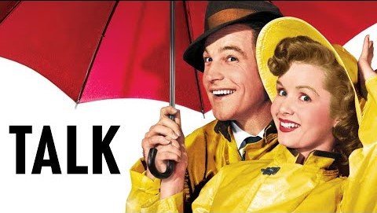

Slide 5
International problems with sound
Sound on films threated the to disrupt the international distribution of films because of the language barrier
By 1929, many producers decided the only way to preserve the foreign markets was to re-shoot additional versions of each film, with actors speaking different languages in each film
By 1931, the technique of mixing separate soundtracks had been enhanced. The original music and sound effects could be combined with new voices, and methods of synchronizing voice and lip movements had improved
Subtitles began to be more accepted

Slide 6
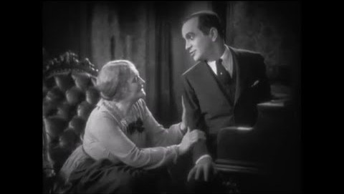
The jazz singer(1927) Dir. Alan Crosland

Slide 7
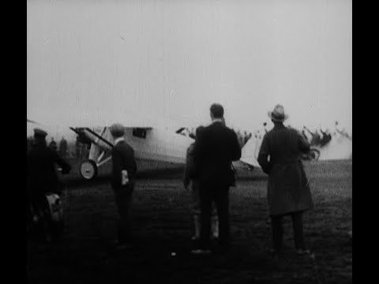
Fox Film newsreel: take off and return of Charles lindberg

Slide 8
Results of sound films
The coming of sound solidified Hollywood’s control over the world market and moved the United States into the studio era
The “Big Five” and “Little Three” movie studios dominated filmmaking, film distribution, and film exhibition
“Big Five”: Paramount, Warner Bros., MGM/Loew’s, Fox Film, and RKO
“Little Three”: Universal, Columbia, and United Artists

Slide 9
Sound Design
Diegetic Sound
Non-Diegetic Sound
Diegetic sound is any sound that originates from the world of a film or TV show, and is often referred to as "actual sound".
Non-Diegetic Sound-a sound that the characters in a film can't hear, but the audience can

Slide 10
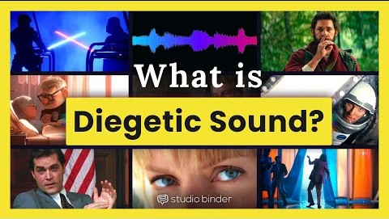

Slide 11
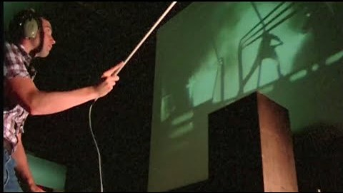

Slide 12


Slide 13
Oppenheimer (2023) Dir. Christopher Nolan
7:07-9:00
1:54-1:59
2:04-2:08
2:42-2:47

Slide 14
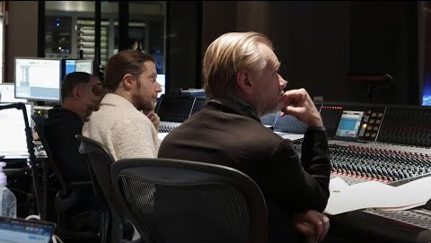

Slide 15
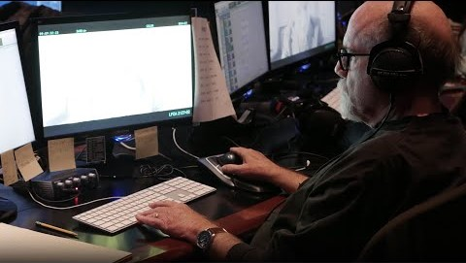

Slide 16
